Slide 1
Chapter 4: Threads

Slide 2
Chapter 4: Threads
Overview
Multithreading Models
Threading Issues
Operating System Examples
Linux Threads

Slide 3
Objectives
To introduce the notion of a thread — a fundamental unit of CPU utilization that forms the basis of multithreaded computer systems
To discuss the APIs for the Pthreads
To examine issues related to multithreaded programming

Slide 4
Motivation
An application is implemented as a separate process with several threads of control
Multiple tasks within the application can be implemented by separate threads
Update display
Fetch data
Spell checking
Answer a network request
Process creation is heavy-weight while thread creation is light-weight
Can simplify code, increase efficiency
Kernels are generally multithreaded

Slide 5
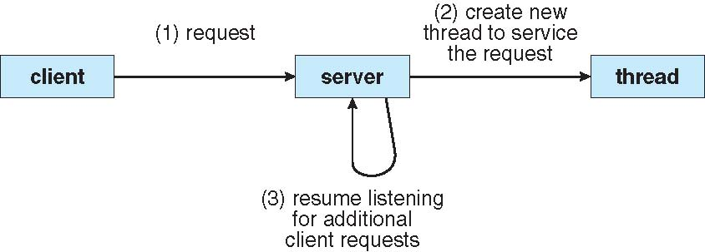
Multithreaded Server Architecture

Slide 6
Threads
A process with only one thread can use only one CPU at a time

Slide 7
Threads
A process with several threads can use several CPUs at a time

Slide 8
Threads and One CPU
A process with several threads can use one CPU more effectively
If thread2 blocks for I/O, thread1 or thread3 can be assigned the CPU

Slide 9
Threads
A thread is a group of instructions that, as a unit, can be assigned to the CPU for execution.
Threads are sometimes called Lightweight Processes
A process ( or task) can have one or several threads.

Slide 10
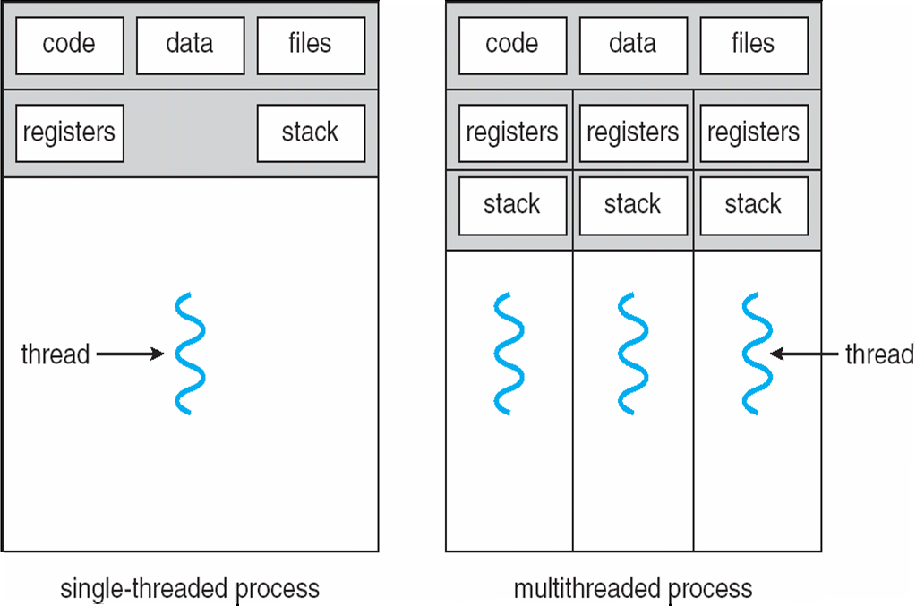
Single and Multithreaded Processes

Slide 11
Benefits
Responsiveness
May allow a program to continue running if part of it is blocked
Resource Sharing
Sharing code, data, memory, and the resources of process
Economy
Allocating memory and resources for process creation is costly
Context switching is faster
More efficient use of multiple CPUs
Automatic speedup as more processors are added in the future
Easier cooperation among threads
Scalability
Threads may be running in parallel on different processors
A single-threaded process can only run on one processor, regardless how many are available

Slide 12
Threads
Threads of the same process share the entire process address space as well as all open files.
Each thread has its own program counter and CPU register set.
Cooperation among threads is much easier
Also context switching among the threads of the same process is faster
Notice the need to protect critical sections
Programmer defines the threads in a process

Slide 13
Thread example

Slide 14
Thread example

Slide 15
Multicore Programming
Multicore systems – system with multiple computing cores that are placed on a single chip
Multithreaded programming provide mechanism for more efficient use of multiple cores and improve concurrency
Multicore systems putting pressure on programmers, challenges include:
Dividing activities
Balance
Data splitting
Data dependency
Testing and debugging

Slide 16
Concurrency vs. Parallelism
Parallelism implies a system can perform more than one task simultaneously
Concurrency supports more than one task making progress
True parallelism or an illusion of parallelism
Single processor / core, scheduler providing concurrency
Concurrent execution on single-core system
Parallelism on a multi-core system:

Slide 17
Multicore Programming (Cont.)
Types of parallelism
Data parallelism – distributes subsets of the same data across multiple cores, same operation/task on each
Example: the task of incrementing elements by one of an array can be split into two: incrementing its elements in the 1st and 2nd halfs
Task parallelism – distributing threads across cores, each thread performing unique operation
In practice, people often follow a hybrid of the two
Architectural support for threading grows
CPUs have cores as well as hardware threads
N hardware threads per core
Means N threads can be loaded into the core for fast switching.
Consider Oracle SPARC T4:
8 cores
8 hardware threads per core

Slide 18
Single and Multithreaded Processes

Slide 19
User Threads and Kernel Threads
User threads
Support provided at the user-level
Managed above the kernel
without kernel support
Management is done by thread library
Three primary thread libraries:
POSIX Pthreads, Windows threads, Java threads
Does not take advantage of multiprocessors
Kernel threads
Supported and managed by OS
Virtually all modern general-purpose operating systems support them

Slide 20
User-level Treads

Slide 21
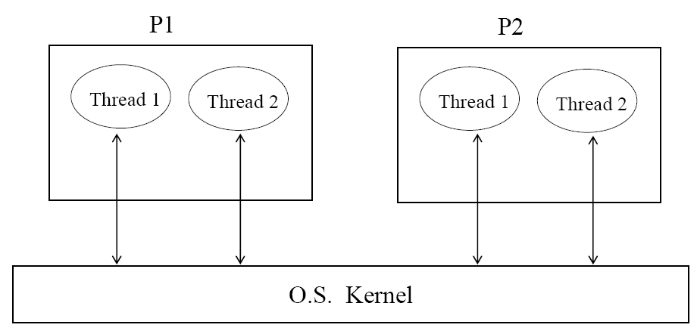
Kernel-level Threads

Slide 22
Kernel-level Threads
Kernel sees every thread of every process. If a thread makes a system call, other threads within that process can run
Switching among threads of a process is done via interrupts
Context switching is slower than for user-level threads but faster than process context switching.
Takes advantage of multiprocessors
Examples
Windows XP/2000
Solaris
Linux
Tru64 UNIX
Mac OS X

Slide 23
Usage of user-level and kernel-level threads
If a process has a group of threads that don’t need system calls then use user-level threads because they are faster
If the threads need system calls then kernel-level threads are better

Slide 24
Multithreading Models
Three common ways of establishing a relationship between user threads and kernel threads are:
Many-to-One
One-to-One
Many-to-Many

Slide 25
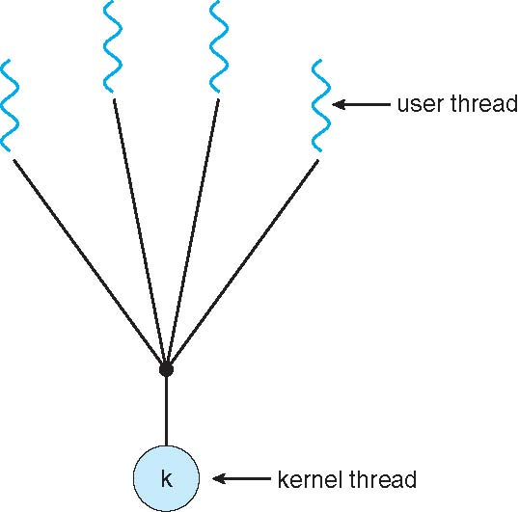
Many-to-One
Many user-level threads mapped to single kernel thread
Thread management is done by the thread library in user space
Efficient but
The entire process will block if a one thread make blocking system call
Examples:
Solaris Green Threads

Slide 26
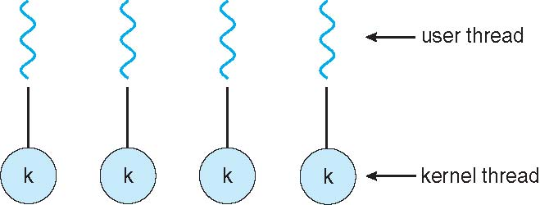
One-to-One
Each user-level thread maps to kernel thread
A blocking system call from thread does not block other threads
Multiple threads to run in parallel on multiprocessors
Disadvantage: overhead of creating kernel threads
Examples
Windows NT/XP/2000
Linux
Solaris 9 and later

Slide 27
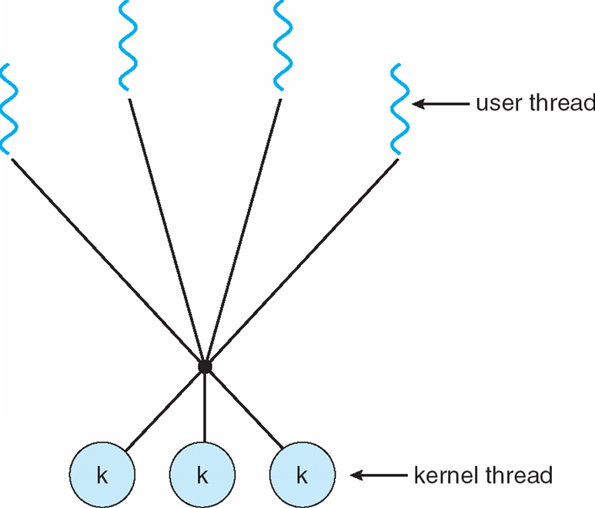
Many-to-Many Model
Allows many user level threads to be mapped to many kernel threads
Allows the operating system to create a sufficient number of kernel threads
Solaris prior to version 9
Windows NT/2000 with the ThreadFiber package

Slide 28
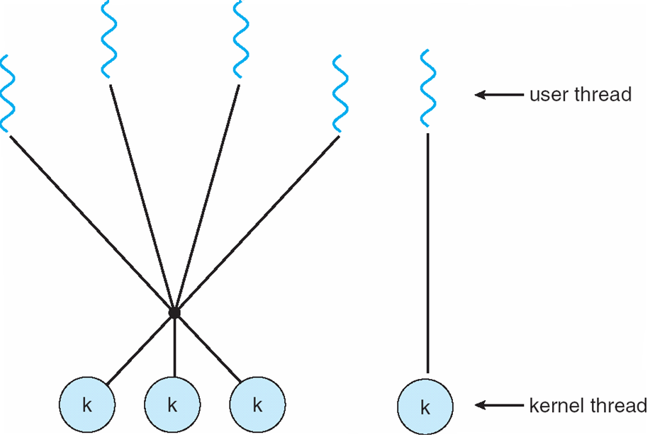
Two-level Model
Similar to M:M, except that it allows a user thread to be bound to kernel thread
Examples
IRIX
HP-UX
Tru64 UNIX
Solaris 8 and earlier

Slide 29
Thread Libraries
Thread library provides programmer with API for creating and managing threads
Two primary ways of implementing
Library entirely in user space
Kernel-level library supported by the OS

Slide 30
Pthreads
May be provided either as user-level or kernel-level
A POSIX standard (IEEE 1003.1c) API for thread creation and synchronization
API specifies behavior of the thread library, implementation is up to development of the library
Common in UNIX operating systems (Solaris, Linux, Mac OS X)

Slide 31
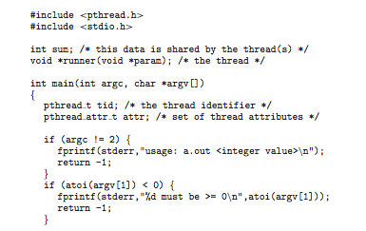
Pthreads Example

Slide 32
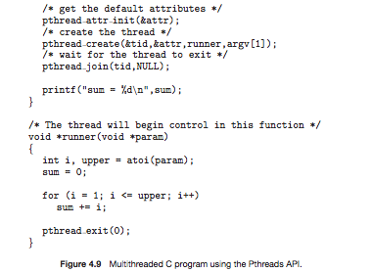
Pthreads Example (Cont.)

Slide 33
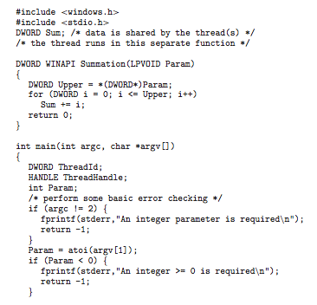
Win32 API Multithreaded C Program

Slide 34
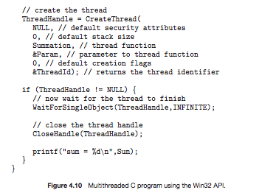
Win32 API Multithreaded C Program (Cont.)

Slide 35
Java Threads
Java threads are managed by the JVM
Typically implemented using the threads model provided by underlying OS
Java threads may be created by:
Extending Thread class
Implementing the Runnable interface

Slide 36
Threading Issues
Semantics of fork() and exec() system calls
Thread cancellation of target thread
Asynchronous or deferred
Signal handling-may be handled by one of two possible handlers:
A default signal handler
A user-defined signal handler

Slide 37
Threading Issues (Cont.)
Thread pools
Thread-specific data
Create Facility needed for data private to thread
Scheduler activations

Slide 38
Semantics of fork() and exec()
Does fork() duplicate only the calling thread or all threads?

Slide 39
Thread Cancellation
Terminating a thread before it has finished
Two general approaches:
Asynchronous cancellation terminates the target thread immediately.
Deferred cancellation allows the target thread to periodically check if it should be cancelled.

Slide 40
Signal Handling
Signals are used in UNIX systems to notify a process that a particular event has occurred.
A signal handler is used to process signals
Signal is generated by particular event
Signal is delivered to a process
Signal is handled
Options:
Deliver the signal to the thread to which the signal applies
Deliver the signal to every thread in the process
Deliver the signal to certain threads in the process
Assign a specific thread to receive all signals for the process

Slide 41
Thread Pools
Create a number of threads in a pool where they wait for work
Advantages:
Usually slightly faster to service a request with an existing thread than create a new thread
Allows the number of threads in the application(s) to be bound to the size of the pool

Slide 42
Thread Specific Data
Allows each thread to have its own copy of data
Useful when you do not have control over the thread creation process (i.e., when using a thread pool)

Slide 43
Scheduler Activations
Both many-to-many and Two-level models require communication to maintain the appropriate number of kernel threads allocated to the application
Scheduler activations provide upcalls - a communication mechanism from the kernel to the thread library
This communication allows an application to maintain the correct number kernel threads

Slide 44
Operating System Examples
Windows XP Threads
Linux Thread
Notes:
44

Slide 45
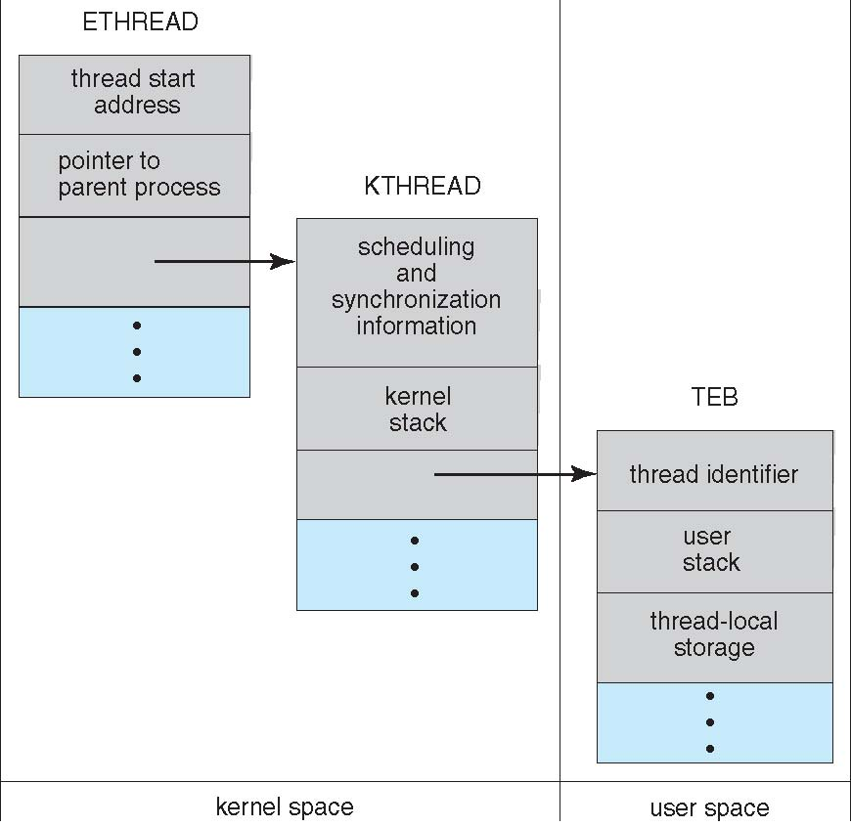
Windows XP Threads Data Structures

Slide 46
Windows XP Threads
Implements the one-to-one mapping, kernel-level
Each thread contains
A thread id
Register set
Separate user and kernel stacks
Private data storage area
The register set, stacks, and private storage area are known as the context of the threads
The primary data structures of a thread include:
ETHREAD (executive thread block)
KTHREAD (kernel thread block)
TEB (thread environment block)

Slide 47
Linux Threads
Linux refers to them as tasks rather than threads
Thread creation is done through clone() system call
clone() allows a child task to share the address space of the parent task (process)
struct task_struct points to process data structures (shared or unique)

Slide 48
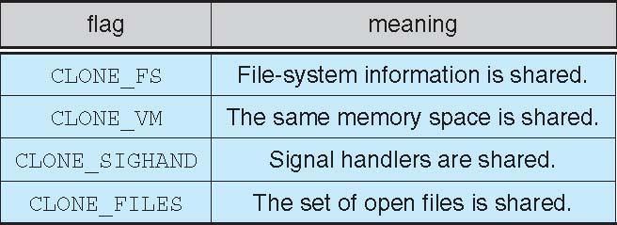
Linux Threads
fork() and clone() system calls
Doesn’t distinguish between process and thread
Uses term task rather than thread
clone() takes options to determine sharing on process create
struct task_struct points to process data structures (shared or unique)

Slide 49
End of Chapter 4

